Slide 1
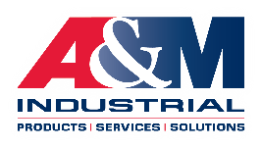
A&M Industrial Inc. for Stanislaus County Safety Council
STRICTLY PRIVATE AND CONFIDENTIAL
Robotics | April 2023

Slide 2
A&M Industrial – Overview
STRICTLY PRIVATE AND CONFIDENTIAL

Slide 3
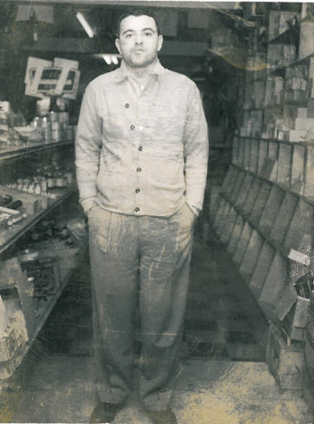
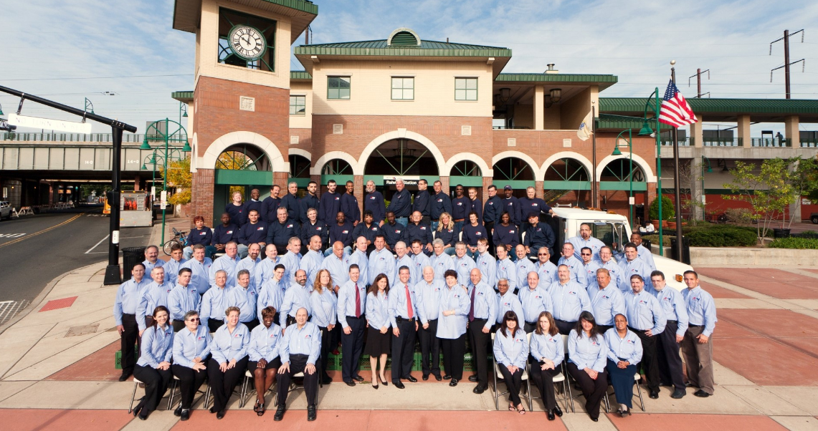
A&M overview
STRICTLY PRIVATE AND CONFIDENTIAL
COMPANY SNAPSHOT
Founded: 1954 in Newark, NJ
Ownership: 3 generations of family leadership
Staffing: 100+ dedicated employees
Locations: 6 sites
Distribution: 160,000 SF footprint
Clients: 2,500+
Founder, Arnold Young (1954)

Slide 4
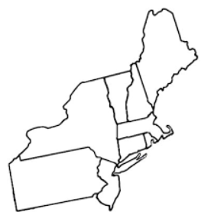
A&M locations
STRICTLY PRIVATE AND CONFIDENTIAL
A&M has six locations with active plans in 2021 to expand physical footprint to Connecticut
Pennsylvania Regional Office
Stroudsburg, PA
New Hampshire Regional Branch
West Lebanon, NH
Connecticut Regional Branch
Southern, CT
Headquarters & Regional Office
Rahway, NJ
Regional Distribution Center
Cranbury, NJ
Safety Services Division
Avenel, NJ
Northern NJ Regional Branch
Fair Lawn, NJ
A&M Locations
A&M Location (Coming Soon)

Slide 5
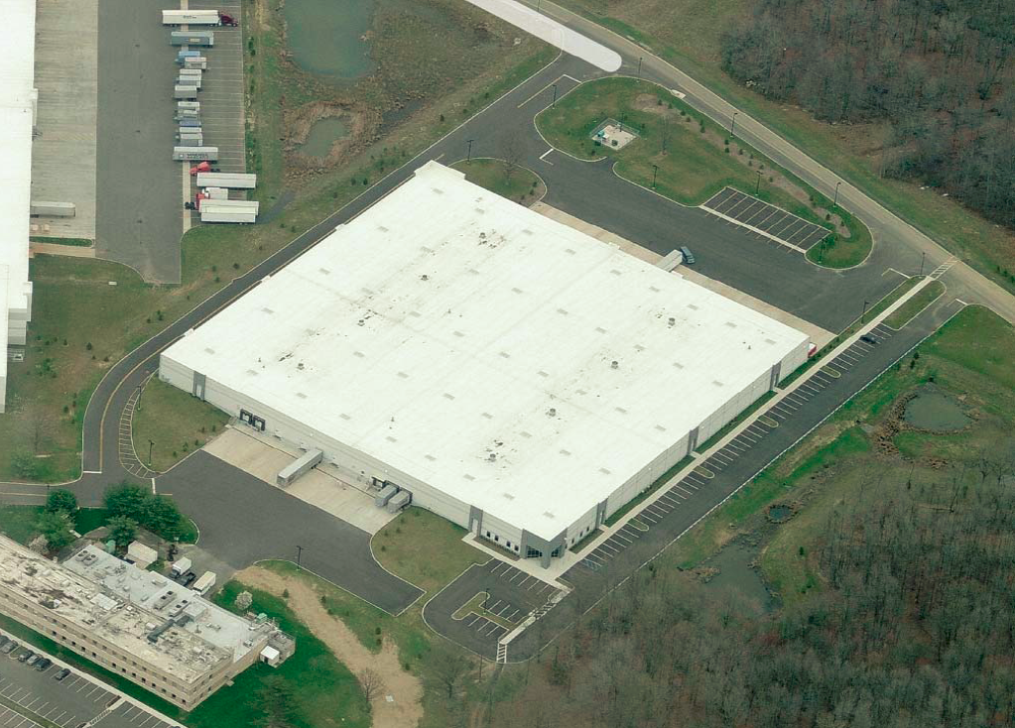
The A&M footprint
STRICTLY PRIVATE AND CONFIDENTIAL
A&M is a well established and trusted value-add service provider and distributor with over 2,500 clients
160,000 SF warehouse
$10 million in inventory
Advanced ERP and logistics systems
15+ years average employee tenure
98% same day shipment of stock items
Cranbury, NJ

Slide 6
Sales composition snapshot
STRICTLY PRIVATE AND CONFIDENTIAL
A&M operates across broad product and industry segments
2020 SALES BY PRODUCT CATEGORY
2020 SALES BY INDUSTRY

Slide 7
Diverse product and service offerings
UPDATE
STRICTLY PRIVATE AND CONFIDENTIAL
INDUSTRY
AFFILIATES
STRATEGIC
PARTNERS

Slide 8
Autonomous Mobile Robots
STRICTLY PRIVATE AND CONFIDENTIAL

Slide 9
Mobile robots: An evolving industry
STRICTLY PRIVATE AND CONFIDENTIAL
What is an Autonomous Guided Vehicle (AGV)?
Vehicle with minimal on-board intelligence
Can only obey simple programming instructions
Vehicles are guided by wires, magnetic strips, or sensors
Guided system typically require extensive (and expensive) facility updates to install and often disrupts production
What is an Autonomous Mobile Robot (AMR)?
Equipped with artificial intelligence to operate autonomously
Does not need to be physically guided
Uses on-board sensors and processors to independently move materials
Utilizes 360-degree scanning to avoid collision and ensure safe routing

Slide 10
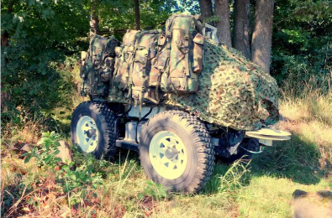
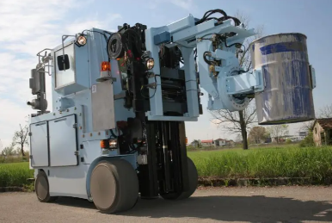
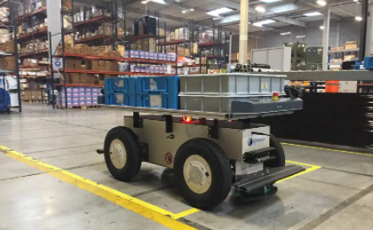
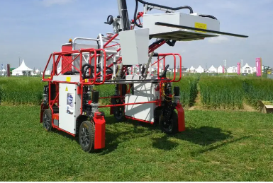
Effidence: Introducing the latest technology in AMRs
STRICTLY PRIVATE AND CONFIDENTIAL
A&M solidified their relationship with Effidence earlier this year as sole distributor of their robots in the U.S.
EFFIDENCE COMPANY SNAPSHOT
French based robotics manufacturer founded in 2009
Dominant player in Europe with strong expertise in autonomous navigation systems for smart handling vehicle applications
Strong presence in the agriculture, defense, construction and warehouse logistics industries
Introduced the EffiBOT in 2016 which is designed for warehouse logistics carting
Plans to release a warehouse logistics robot in 2022 for autonomous pallet handling

Slide 11
The A&M AMR advantages: Offering a fully integrated custom solution
STRICTLY PRIVATE AND CONFIDENTIAL
Improved productivity through reduction of repetitive tasks involving product transportation
Operate fully autonomously and does not require changes to existing facility
Attractive return on investment with payback between two and three years driven by productivity increases and cost save
Enhanced workplace safety by reducing employee accidents related to product movement
Global supply chain optimization – fleet control capability to scale and streamline bot-driven efficiencies
Allows for a more sustainable operation driven by robot consistency with virtually no down time

Slide 12
Effidence introductory video
STRICTLY PRIVATE AND CONFIDENTIAL
Effidence Introductory Video

Slide 13
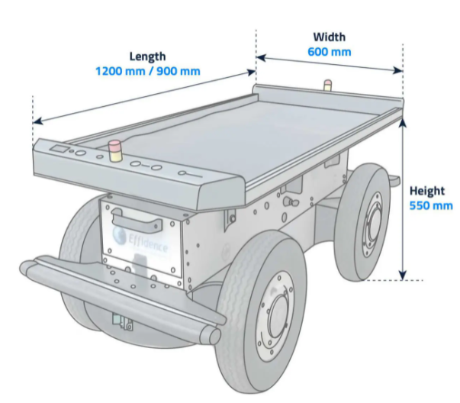
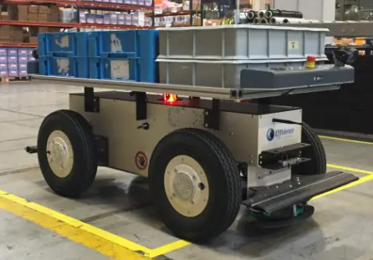
The EffiBOT: One of the most technologically advanced AMRs
STRICTLY PRIVATE AND CONFIDENTIAL
SPECIFICATIONS
35 or 27 inches
24 inches
KEY FEATURES
Payload: 660lbs
Towing: 1,100lbs
Max Speed: 3.7MPH
Battery life: 6-8 hours
Weight: 290 pounds
Communication: WiFi to program
CE Certified
Autonomous onboard navigation:
Wheel encoder
Lidar
3D cameras
Inertial measurement unit
Full maneuverability with the ability to drive forwards and backwards
360-degree full sensor architecture to ensure employee safety
Equipped with the industry sought after “follow-me” feature
Autonomous loading and unloading capability
Various add-ons available to enhance carrying capabilities
User friendly touch screen/initial programming
Fleet coordination system available
Operates independently without WiFi
24 inches

Slide 14
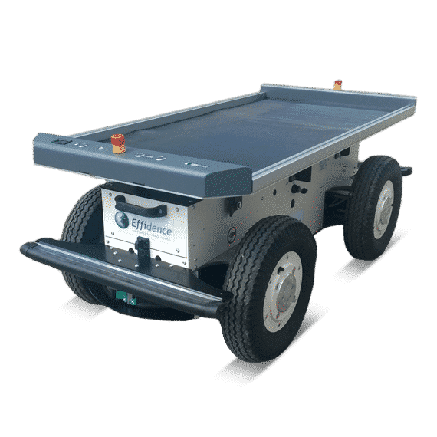
Video demonstration
STRICTLY PRIVATE AND CONFIDENTIAL
Video 1: About Effidence and the EffiBOT-
Video 2: Follow-me feature with trailer integration
Video 3: 3D cart grip
Video 4: Follow-me feature with 3D cart grip
Video 5: Conveyer set-up
Video 6: User-friendly mapping software

Slide 15
A&M-Effidence competitive advantages
STRICTLY PRIVATE AND CONFIDENTIAL
EASE OF USE
TECHNOLOGY
COST SAVINGS
VERSATILITY
No experience required to program
Initial setup is simple with A&M robotics team providing support along the way
User friendly software –can be integrated with other platforms
No WiFi or cloud service required to use robot
Unique “follow-me” capability virtually unmatched in AMR space
Does not require guided lines to operate
Facility scanned and automatically mapped by the robot
360-degree sensors to avoid collisions
Attractive selling point with outsized feature offering
30-50% productivity enhancement/cost save potential per robot
1–3-year payback period with additional cost save related to workforce injury reduction
Various attachments and pairing options
Ability to stop instantly and maneuver in tight areas
660 pound carrying capacity with 1,100-pound towing
Able to handle difficult terrain, inclines, wet surfaces and various weather conditions

Slide 16
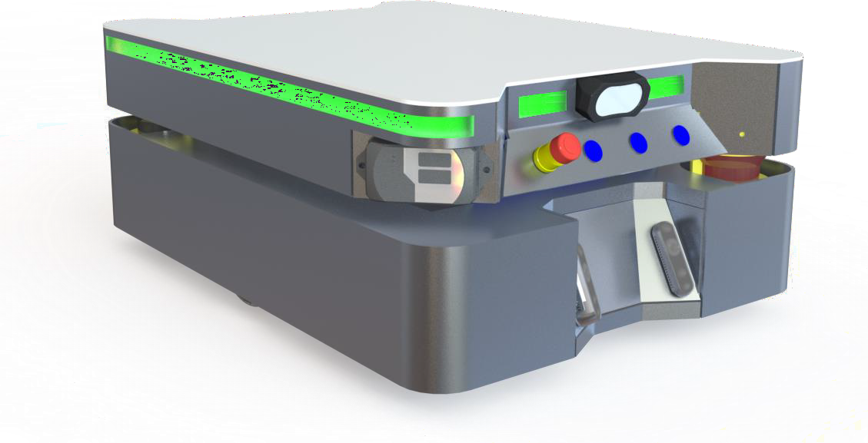
Coming soon EffiBOT XL: Autonomous pallet transporting
STRICTLY PRIVATE AND CONFIDENTIAL
Weight | 573 lbs
Slope | 5%
Max speed | 2.7 mph
Max load | 2,200 lbs
Operating condition | 41 - 104°F
Operating time | 8h Battery Lithium (48V, 34Ah)
Charging | Automatic wireless charging
Communication | Wifi 2.4/5GHz

Slide 17
