Slide 1
STANISLAUS COUNTY CUPA
Beronia Beniamine
Hazardous Materials Division Manager
bbeniamine@envres.org

Slide 2
Stanislaus County CUPA
AST/SPCC
UST
Hazardous Materials Business Plans (HMBP)
Hazardous Waste and Onsite Hazardous Waste Treatment (Tiered Permitting)
Hazardous Materials Management Plans and Hazardous Materials Inventory Statement
CalARP

Slide 3
Stanislaus County CUPA
Non-CUPA programs:
Medical Waste
Emergency Response The Household Hazardous Waste Collection, including:
Collection Facility, 1710 Morgan Rd., Modesto
Mobile Collection Events in 8 cities
Staff:
4 full time inspectors, 1 part time inspector
3 full time seniors, 1 part time senior
2 technicians

Slide 4

CERS

Slide 5
What is CERS?
CERS = California Environmental Reporting System
A statewide, web-based system created by the State of California for use by the State
Used to electronically report, collect, and manage hazardous materials-related data from the regulated community and Unified Program Agencies.
Mandated by the California Health and Safety Code through AB 2286
Notes:
READ

Slide 6
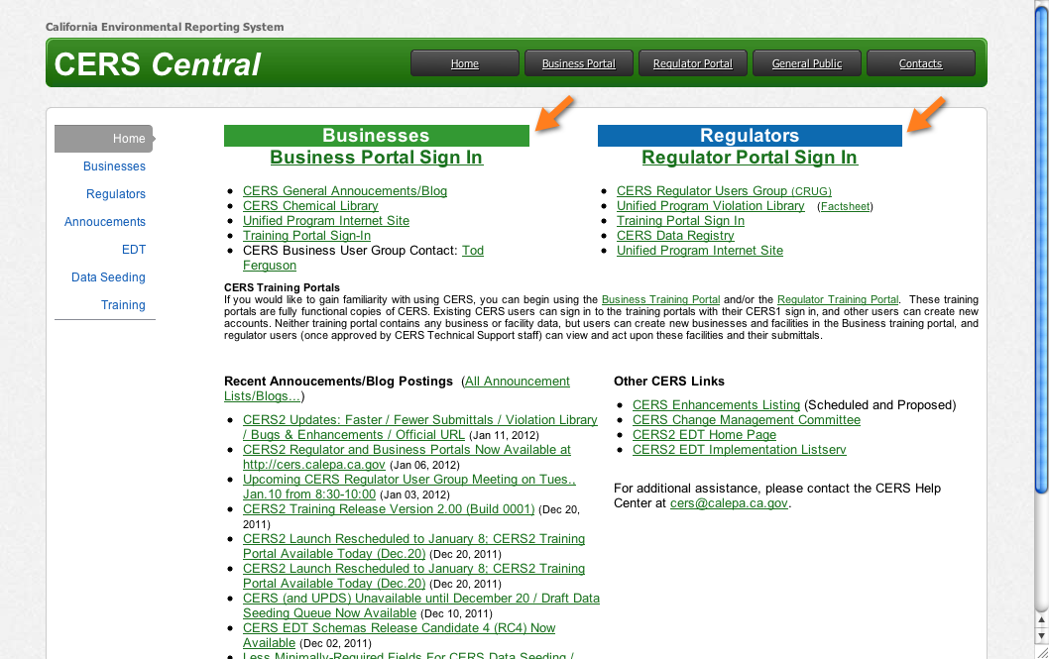
CERS Central http://cers.calepa.ca.gov/
Notes:
Business and Regulator sign-in portals
-> http://cers.calepa.ca.gov/

Slide 7
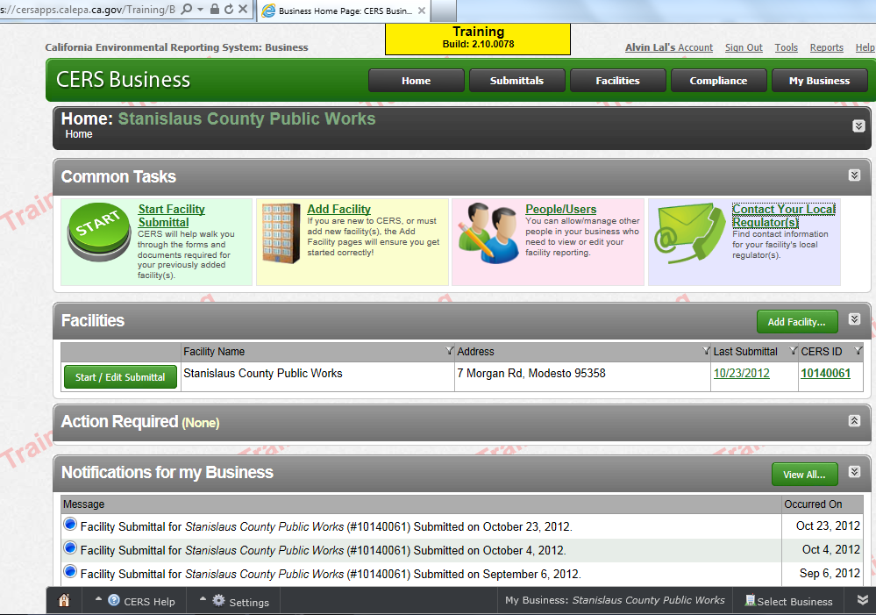
Selecting Your Site
Notes:
Common Tasks is how you will manage your facilities/business

Slide 8

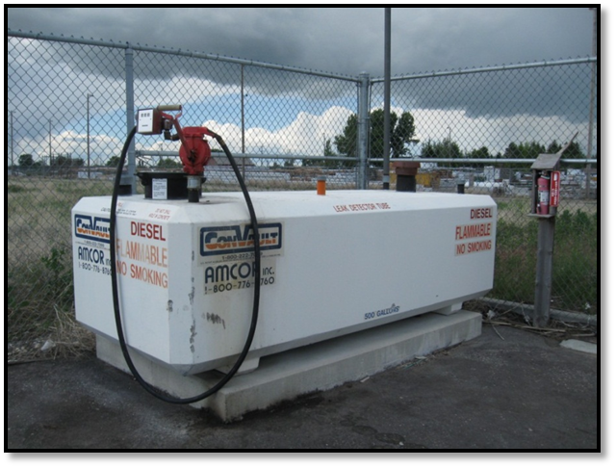
Aboveground Storage Tanks (ASTs)
What is an AST?
“… a tank that has the capacity to store 55 gallons or more of petroleum and is substantially or totally above the surface of the ground.” [H&SC 25270.2(a)]

Slide 9
A facility is subject to APSA if:
The facility is subject to the oil pollution prevention regulations in 40 CFR, 112 or has a storage capacity of 1,320 gallons or more of petroleum (only containers 55 gallons or greater in capacity are counted towards the 1,320 gallons).
The California APSA only regulates petroleum;
the federal SPCC Rule regulates OIL
Notes:
Your facility will be regulated under APSA if the facility is subject to the oil pollution prevention regulations at 40 CFR, 112 or has a storage capacity of 1,320 gallons or more of petroleum
--APSA only regulates Petroleum, SPCC regulates OIL--
(H&SC 25270.3 states that regardless of whether the tank facility has a reasonable expectation of discharging oil to a navigable waterway, if the tank facility is subject to the oil pollution prevention regulations specified in Part 112 commencing with Section 112. 1 of Subchapter D of Chapter I of Title 40 of the Code of Federal Regulations they are subject to APSA. )

Slide 10
ASTs (cont’)
Operator subject to the requirements of APSA shall:
Prepare and implement a Spill Prevention Countermeasure & Control Plan (SPCC) (40 CFR Part 112)
Conduct periodic self inspections
Submit SPCC Plan and Aboveground Petroleum Storage Tank Facility Statement to CUPA

Slide 11
ASTs (cont’)
Operator subject to the requirements of APSA shall:
4. File a tank facility statement with the CUPA. (by submitting your CUPA annual inventory form in CERS, you’re good)
Upon discovery of the occurrence of a spill or other release of one barrel (42 gallons) or more of petroleum, to notify the Governor’s Office of Emergency Services AND the CUPA (Stanislaus County DER).

Slide 12
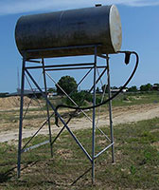
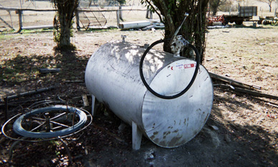
APSA Exemptions: Conditional
A farm, nursery, logging site, or construction site would be exempt only under CA Law from preparing an SPCC if:
No storage tank at the location exceeds 20,000 gallons, and
The cumulative storage capacity of the facility does not exceed 100,000 gallons
Notes:
As I said earlier, California APSA conditionally exempts farms, logging sites and construction sites if:
1-no storage tank exceeds 20,000 gallons, and
2-the cumulative storage capacity does not exceed 100,000 gallons.

Slide 13
APSA Exemptions: Conditional
A tank facility located on a farm, nursery, logging site, or construction site, is still regulated under APSA, but the facility is not required to prepare and implement a SPCC Plan AS LONG AS:
You conduct a daily visual inspection each day of operation of any storage tanks storing petroleum.
The CUPA conducts periodic inspections (at least every 3 years)
Facility installs secondary containment if the local CUPA determines it is necessary for the protection of the waters of the state
These facilities still need an SPCC to meet Federal Req’s
Notes:
To maintain the this conditional exemption, sites must
*conduct daily inspections,
*allow the CUPA to perform inspections at the facility,
*and if asked to do so, install secondary containment.
*(NOTE: these facilities are not exempt from federal SPCC requirements enforced by US EPA.)

Slide 14
SPCC update & current requirements
Water Resources Reform and Development Act (WRRDA) of 2014 changed the applicability provisions and criteria for self-certification of SPCC plans for farms. In summary, farms have been recognized by the Federal Government as eligible for some exemptions when they write their SPCC, and the Office of the State Fire Marshall has now extended some of these exemptions to the farms, if they follow the appropriate procedures.
The guidance is very informative and can be found at the following link:
http://osfm.fire.ca.gov/cupa/pdf/Farm_Fact_Sheet_26Jan2016.pdf

Slide 15
SPCC update & current requirements
Office of the State Fire Marshall has the CUPA (Stanislaus County DER) collect $26 for each facility that has storage capacity of 1,320 gallons or more if they are not conditionally exempt.
Conditional exemption is only valid for the facilities that follow the rules of conditional exemption, which includes daily visual inspections and the documentation of the daily visual inspection.
If the conditional exemption rules are not followed, the facility cannot enjoy the conditional exemption benefits.
For some facilities that can self-certify their SPCC plan, there is little or no benefit to obtain conditional exemption.
DER staff is happy to assist with determining if you should try to obtain conditional exemption.

Slide 16
SPCC update & current requirements
Stanislaus County DER went to the Board of Supervisors this year to adjust the fees charged annually for facilities that have over 10,000 gallons of petroleum storage capability.
Based upon how the Health and Safety Code is written, DER decided to still not assess a fee upon those facilities that have less than 10,000 gallons because the law is clear that the Department does not have to inspect them every three years, unlike facilities that have over 10,000 gallons- which must be inspected triennially.
Facilities, although not necessarily inspected for this program, MUST have an SPCC, and pay the Office of the State Fire Marshall the $26 annual surcharge (collected by DER).

Slide 17
Hazardous Materials Release Response Plan & Inventory [H&SC Ch 6.95]
A Hazardous Materials Business Plan is a document containing detailed information on the :
Hazardous materials at the site
Emergency response plans and procedures in the event of a reportable release or threatened release of a hazardous material
Training for employees in safety procedures in the event of a release or threatened release of hazardous materials
Notes:
to provide emergency responders (health, fire, medical aid, etc) with critical information needed to respond to any type of an emergency at a business and treatment of individuals involved in emergencies as a result of hazards at a business (employees and citizens. Information is used not only for hazmat release response but fire, flood, earth quake, medical aid. Also inventories can be utilized to determine evacuation and decontamination information. Second key intent is to allow private citizen with access to information on the hazards associated with particular businesses within the community.

Slide 18
Hazardous Materials Business Plan
A hazardous material is any material that because of its quantity, concentration, or physical or chemical characteristics poses a significant threat to human health and safety or the environment if released. H&SC 25501(o)
Equal to or greater than the total weight of 500 pounds or a total volume of 55 gallons,
Equal to, or greater than, 200 cubic feet if the substance is a compressed gas, and
Extremely hazardous substances (defined in 40 CFR 355.61) must be listed at their threshold planning quantity, and if less than 500 pounds.

Slide 19
Hazardous Materials Business Plan
What is considered a hazardous material?
“…any material that because of its quantity, concentration, or physical or chemical characteristics poses a significant present or potential hazard to human health and safety or the environment if released into the work-place or environment." H&SC
This includes substances that are:
- flammable - radioactive
- corrosive - combustible
- reactive - toxic
- oxidizers
Notes:
Because of the broad definition of this law, if a substance is considered hazardous under any other environmental, safety, or transportation law or regulation, it is likely to meet the definition of hazardous material for this law. These include substances that require a Material Safety Data Sheet under worker protection laws, substances that are regulated as hazardous under transportation laws, and substances that are listed as radioactive under federal environmental regulations.

Slide 20
Hazardous Materials Business Plan
Common hazardous materials stored on farms:
Diesel
Gasoline
Hydraulic oil
Motor oil
Propane
Compressed gases (oxygen, argon, acetylene)
Paint & paint thinner
Notes:
Because of the broad definition of this law, if a substance is considered hazardous under any other environmental, safety, or transportation law or regulation, it is likely to meet the definition of hazardous material for this law. These include substances that require a Material Safety Data Sheet under worker protection laws, substances that are regulated as hazardous under transportation laws, and substances that are listed as radioactive under federal environmental regulations.

Slide 21
Hazardous Materials Business Plan
Hazardous Materials Business Plan Elements
Owner Operator Page
Chemical Inventory
Site Map
Emergency Response Plans and Procedures
Training Program

Slide 22
Hazardous Materials Business Plan
Hazardous Materials Business Plan Elements
Owner Operator Page
Facility owner and/or operators
Emergency contacts
Point of contacts for inspections
After hours emergency mitigation personnel

Slide 23
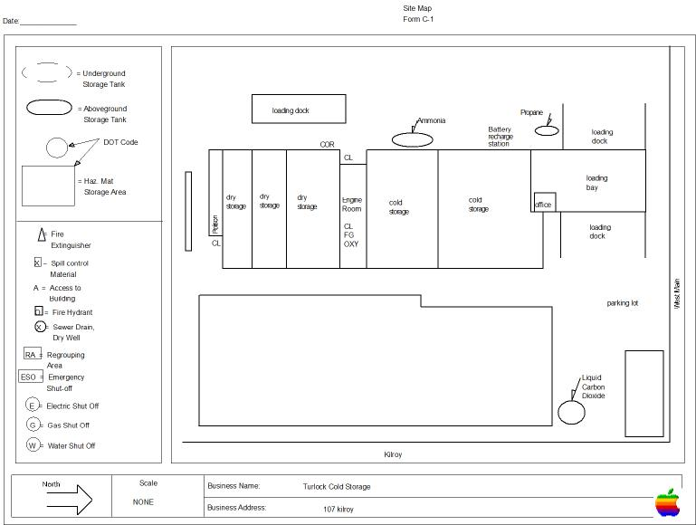
Hazardous Materials Business Plan
Hazardous Materials Business Plan Elements
Site Map
Chemical storage areas
Utility/Emergency shut off
Evacuation/Regrouping areas
North arrow
Adjacent streets and property

Slide 24
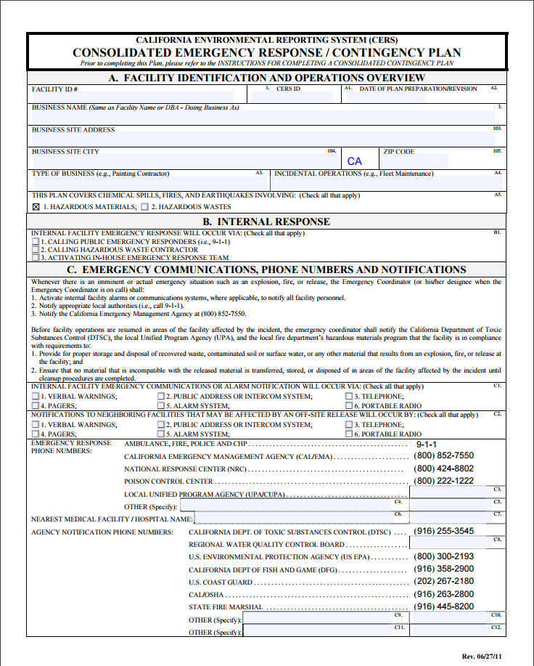
Hazardous Materials Business Plan
Hazardous Materials Business Plan Elements
Emergency Response Plans & Procedures
Mitigation, Prevention, or Abatement Procedures
Notification & Evacuation Procedures
Notifications
Local Emergency Response (911)
Administering Agency
Stanislaus County: 525-6700, 525-6727
Cal OES
in CA: (916) 845-8911, (800) 852-7550
Local Emergency Medical Assistance

Slide 25

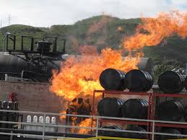
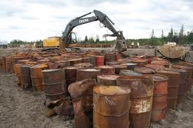
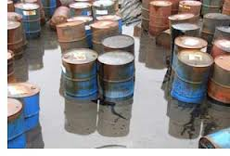
Hazardous Waste Generator

Slide 26
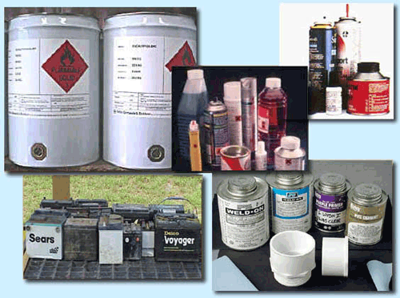
Hazardous Waste
When is it hazardous?
“… A waste is hazardous when its quantity, concentration, or physical, chemical or infectious characteristics cause or contribute to an increase in serious illness…” (H&SC 25141)

Slide 27
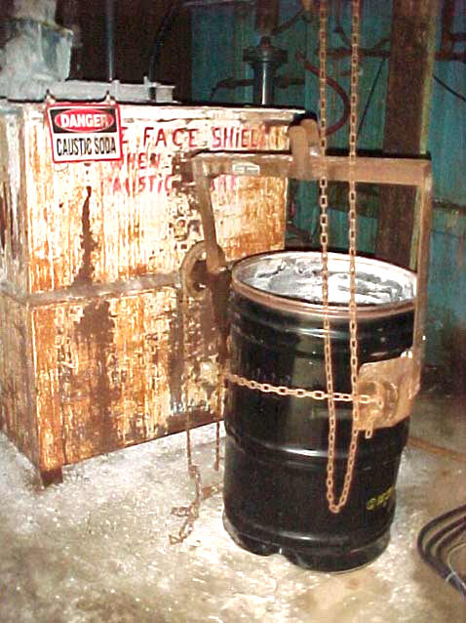
Hazardous Waste
Purpose of this program is to ensure that hazardous waste will be properly managed to protect public health and environment
This program covers Hazardous Waste Generators and Onsite Hazardous Waste Treatment (Tiered Permitting) Programs

Slide 28
Hazardous Waste
Requirements of a hazardous waste generator?
Container/tank management
Proper waste disposal
Manifest/record keeping
Prepare for emergencies onsite
Provide training for employees

Slide 29

Hazardous Waste
What is a waste generator class?
For an operator, this designates the level of regulatory requirements as well as determines his/her waste generator status [monthly volume of waste(s) generated onsite]

Slide 30
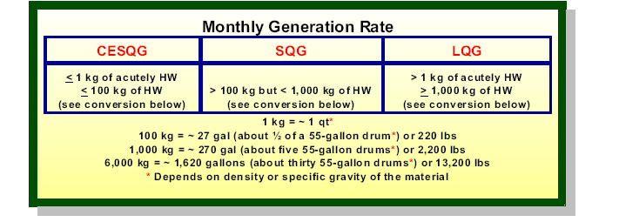
HW Generator Status

Slide 31
Hazardous Waste Update
The EPA Administrator signed the proposed Hazardous Waste Generator Improvements Rule on August 31, 2015, and it was published in the Federal Register (FR) on September 25, 2015.

Slide 32
Two key provisions where EPA is proposing flexibility are:
Allowing a hazardous waste generator to avoid increased burden of a higher generator status when generating episodic waste provided the episodic waste is properly managed and
Allowing a conditionally exempt small quantity generator (CESQG) to send its hazardous waste to a large quantity generator under control of the same person.

Slide 33
Further, the EPA is proposing a number clarifications without increasing burden including a reorganization of the hazardous waste generator regulations so that all of the generator regulations are in one place.

Slide 34
Tiered Permitting (TP)
Onsite treatment of HW in a 5 Tiered Program
Treatment means changing the physical, chemical or biological composition; and, by that change make it less or non-hazardous or easier to dispose of [H&SC Sec 25123.5 and 25179.2(e)]
CUPA regulates only 3 Tiers (Permit by Rule, Conditional Authorization, Conditionally Exempt )

Slide 35
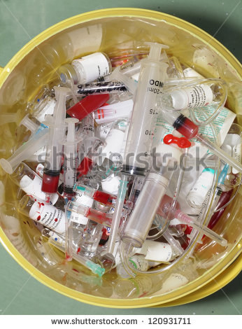

Medical Waste
The Medical Waste Management Act was amended January 2015, changes include:
Additional information musty be included in the Medical Waste Management Plan
We no longer issue Limited Quantity Haulers Exemptions, all Medical Waste transportation to adhere to DOT regs
Facilities are now required to notify DER of participation of temporary off-site events (117890)
Facilities with on-site treatment must provide training
Biohazard bags must meet updated standards
Notes:
-Off-site events: must notify DER od any off-site events they participate in (vaccination clinic, health fairs, etc). We do not charge for this, no form, no permit, but they still have to notify us so we can put in file
-LQHE: previously, haulers of small amount of medical waste were required to have a LQHE from DER, now they have to adhere to DOT (materials of trade exemption) which allows the transportation of up to 37.5 pounds of medical waste (>35.2 pounds requires a hazardous waste haulers license).
-Additional Information in MWMP: the additional information in the MWMP include how they will categorize pharm waste, and a closure plan for any on-site treatment.
-Training: includes documented initial and annual training for treatment operators
-Biohazard Bags: Bags must now meet DOT standards.

Slide 36
PSM, RMP, CalARP
Facilities that have a process that contains above a threshold quantity of a State and Federal listed acutely hazardous material.
For example, anhydrous ammonia is a listed chemical; threshold quantity is 10,000 pounds. Ammonia in a refrigeration system is considered a “process.”
Note: In CA ammonia over 500 pounds in a refrigeration system is considered a “process”

Slide 37
Regulatory Intent
Review of critical plant features to verify the implementation and effectiveness of :
Appropriate design criteria
Operating conditions and procedures
Safety measures
Related risk management programs and
CalARP & RMP compliance

Slide 38
The Differences Between Program 2 & Program 3
Program 2 Requirements
Safety Information
Operating Procedures
Training
Maintenance
Incident Investigation
Hazard Review
Compliance Audits
Program 3 / PSM Requirements
Process Safety Info.
Operating Procedures
Training
Mechanical Integrity
Incident Investigation
Process Hazard Analysis
Employee Participation
Contractors
Hotwork Permit
Management of Change
Pre-startup Safety Review

Slide 39
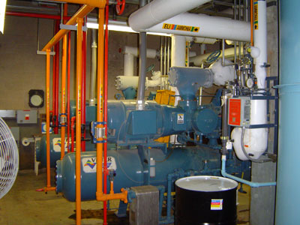
CalARP Changes
“Cal EMA” changed to “Cal OES” throughout the document
•General language listing “OSHA or CalOSHA” instead of “Federal or State”
Applicability: “Response or restoration activities for an exposure of an environmental receptor or a public receptor…” §2735.4(c)(1)(C)
General Requirements: “Ensure that response actions have been coordinated with local emergency planning and response agencies (e.g., site visits by first responders)…” §2735.5(d)(3)

Slide 40
CalARP Changes
Submission
§2745.1(b): Removed inconsequential dates (i.e., submitting RMP information by June 21, 1999)
§2745.1(d) replaced an existing stationary sources with “new or modified”
§2745.1(h) removed discussing information updates regarding submissions prior to June 21, 2004,and added classified information discussion

Slide 41
CalARP Changes
Review Process
§2745.2(a)(2)-removed initial public notice from the review process
§2745.2(c): “Formal Evaluation Review…the AA shall make the RMP available to the public for review and comment by publishing a notice in a local newspaper of general circulation or on the AA’s website…”
§2745.2(g): added :Subject to the requirements of section 2775.5(b), the public shall have access to the RMP…”

Slide 42
CalARP Changes
Executive Summary
RMP Executive Summary Component - §2745.3: Added : “The owner or operator shall provide in the RMP, for all Program levels, an executive summary…”

Slide 43
New timelines for Follow-up on Recommendations
2015 CalARP regulations require SS to assign responsibility and inter into agreement with AA on a timetable for addressing the recommendations, otherwise the target date will be:
HR/PHA-2.5 years of performing the PHA, or the next planned turnaround for those items requiring a turnaround
Compliance Audit-1.5 year after performing the compliance audit, or the next planned turnaround for items requiring a turnaround
Incident Investigations-1.5 year after completion of incident investigation, or 2 years after the date of incident, whichever is the earliest of the two.
Notes:
Turnaround: means a planned process shutdown for the purpose of repair, maintenance, process modification, equipment upgrade or other significant process activity.

Slide 44
CalARP Changes
Hazard Review
§2755.2(c): added “…The hazard review shall be performed by a team familiar with process operations and shall include at least one employee who has experience and knowledge specific to the process being reviewed…”
§2755.2(e): added deadline -2.5 years of performing the HA, or the next planned turnaround for those items requiring a turnaround.
Added: Final resolution and completion date on any deficiencies found during HR must document.

Slide 45
CalARP Changes
Hazard Review (cont’)
§2755.2(f): “The hazard review shall be updated and revalidated…”
Added §2755.2(g): “A hazard review may be revalidated only once between full hazard reviews, unless the AA agrees in writing that a full hazard review is unwarranted.”
Added §2755.2(h): “The owner or operator shall retain hazard reviews and updates or revalidations for each process covered by this section, as well as the documented resolution of recommendations described in (e) for the life of the process.”

Slide 46
CalARP Changes
Operating Procedures
§2755.3(c) changed to read: “The owner or operator shall ensure that the operating procedures are developed and/or updated, as necessary, to reflect current practice, or whenever the tasks or steps to perform on the covered process are found to be inadequate or inaccurate.”

Slide 47
CalARP Changes
Training
§2755.4(d): added“…operators are trained in any updated or new procedures prior to needing to use the procedures.” in place of “operators trained in any updated or new procedures prior to start up of a process after a major change” :
Added §2755.4(e): “The owner or operator shall document initial and refresher training for each employee.”

Slide 48
CalARP Changes
Maintenance/Mechanical Integrity
§2755.5(a) includes a language for owners/operators to have written procedures.
§2755.5(c) changed to read: “The owner or operators shall ensure that each contractor can document that their employees are trained to perform the maintenance and appropriate operation procedures developed under section (a).”
§2760.5(a)(2) replaced “piping components” with “ancillary components”
§2760.5(a)(6) added compressors and their drivers.

Slide 49
CalARP Changes
Pre-Startup Safety Review
Title renamed to be “Pre-Startup Safety Review”
§2760.7(b):“The pre-startup safety review shall confirm, as a verification check, independent of the management of change process, that prior to the introduction of regulated substances…”

Slide 50
CalARP Changes
Contractors
§2760.12(b)(5) changed to read: the owner/operators shall periodically evaluate and document the evaluation of the performance of the contract owner or operator in ….

Slide 51
CalARP Changes
Emergency Response Applicability
§2765.1(b)(1): includes language that a facility must be under a community response plan, a city/county Hazardous Materials Area Plan, and/or in the business plan program. And the owner/operator must document response actions coordinated with local response agencies.
• §2765.1(b)(2) for flammables requires that coordination with local agencies must be documented.
• §2765.1(b)(3): “Appropriate mechanisms and written procedures are in place to notify emergency responders when there is a need for response”

Slide 52
CalARP Changes
Availability of Information to the Public
§2775.5 added clarification for the exception of OCA information being released to the public.
Adds §2775.5(b): “The AA shall ensure that any member of the public has access, by appointment, to a copy of the offsite consequence analysis data, pursuant to Section 2745.4. The member of the public may read, but not remove, reproduce, print, scan or image the documents. The AA may require personal photo identification issued by a Federal, State or local government agency to the person, and may require the person’s signature on a sign-in sheet. The AA may limit a person’s access to offsite consequence analysis data to 10 stationary sources in any calendar month.”

